Slide 1

Property Management & Leasing Platform
An Overview, Model & Solution

Slide 2

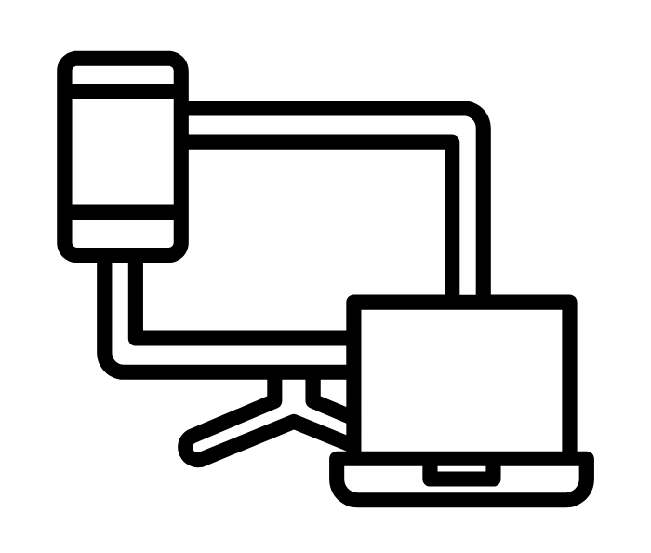


“The Digital Real Estate Opportunity"
+
Gap in fully digital, integrated leading platforms in India
First Mover advantage for
Early movers gain advantage through transparency and automation.

Slide 3
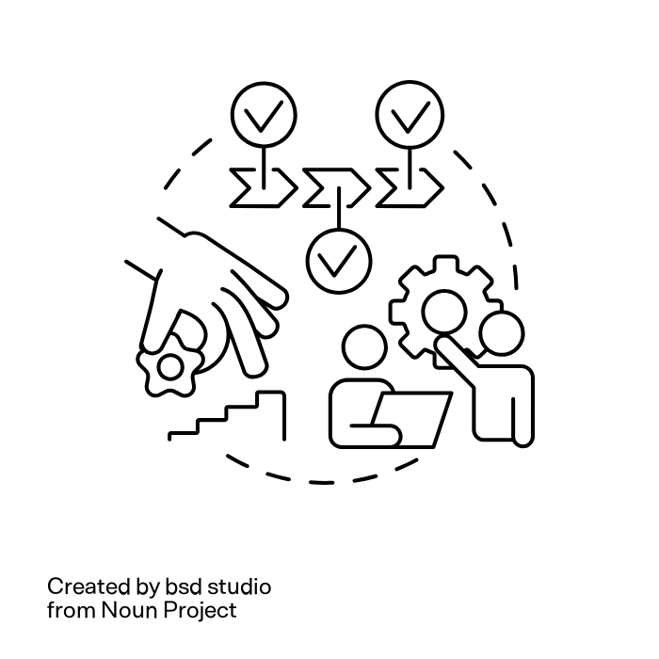
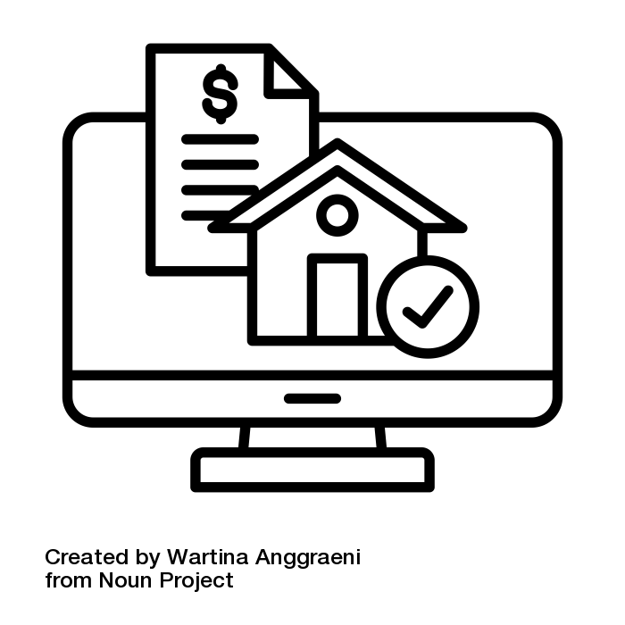

“Platform Vision – What We’re Building"
Platform for Owner, Tenant & Admin
Web Application
Scalable, Secure & User-friendly

Slide 4



“Visualizing the Product"
Owner Panel
Tenant Portal
Admin Panel
Tracking Dashboard
Rental Statement
Notification & Alerts
AMC Overview
Home Screen Dashboard
Rent Payment & Download Receipts
Help & Support
Master Dashboard
User Management
Exit Workflow
AMC Management

Slide 5

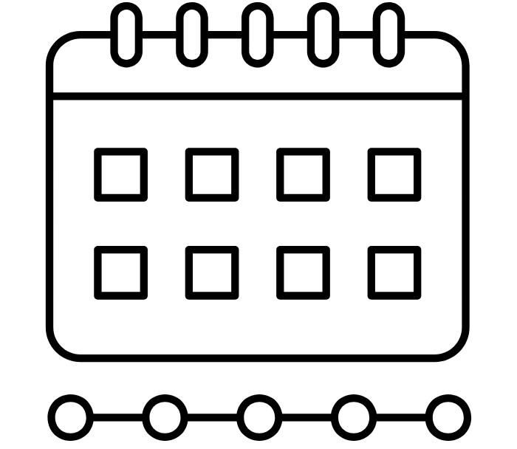
“Budget & Timeline”
Budget
Timeline
₹ 60 Lakhs
9 Months

Slide 6

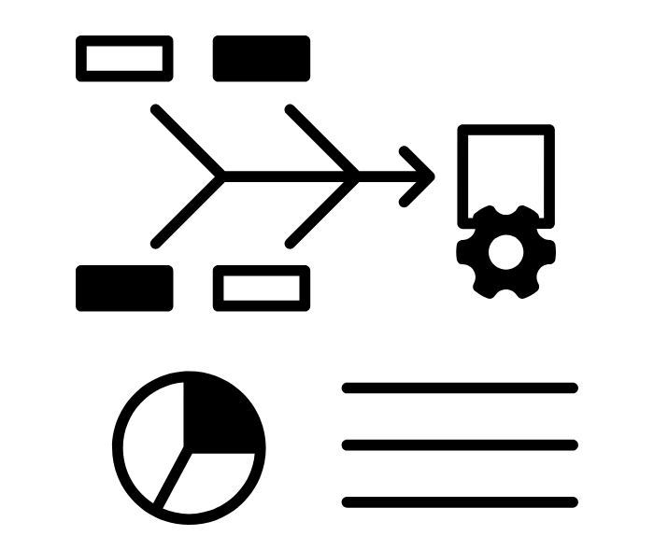

“Our Dedicated Product Team – Your In-House Squad"
THE DEVENGERS
OUR METHODOLOGY
COMMUNICATION
6-9 Members
PM
BA
Backend Devs
Frontend Devs
QA,
Designer
DevOps
Agile Delivery
Bi-weekly Sprints
Frequent Updated
Continuous integration
SPOC assigned both sides
Calibration Call – 2 Weeks
Updates:
SPRINT Report
Roadmap Sync
Complete Control on the process

Slide 7
“Why this Strategy?”
Phased spend = lower risk: scalable with results
Flexible Scope Control: GAP Group decides pace, not locked in up-front
Perceived value: bundled services, no cost spikes
Client retains control and IP from day one

Slide 8
“What's the Cost of NOT Doing This?"
Delayed launch = lost investor trust and monetization
Missed first-mover advantage in digital leasing
Fragmented DIY path = risk of failure, rework
In-house hiring = ₹2 Cr+ fixed annual cost
Rebuilding poor MVP = Brand Damage + Future Cost
“Our retainer model isn't just cheaper upfront — it's safer, faster, and more outcome-focused in the long run.”

Slide 9
What You Get Every Month?”
UX designs & stakeholder approvals
Frontend/backend feature drops
Tested releases
Bug fixes, infra monitoring
Sprint report + roadmap sync

Slide 10
“Tech & Infrastructure Highlights"
React, Node, PostgreSQL, AWS, Payment Gateway integration
API-first microservices architecture
Security, compliance, full data ownership

Slide 11
"Governance & Delivery Process"
Weekly sprint updates, monthly reviews
Slack/Zoom communication, escalation path
Monthly milestone review
Escalation & SLA-backed delivery and support

Slide 12
“Risk Management & IP"
100% IP belongs to client
CI/CD pipelines, disaster recovery
Full disaster recovery & Code back-ups
Follow complete SDLC process in development

Slide 13
Why Us – Product + Domain Confidence
Product-led team, not just coders
Experience in building successful
SaaS Products
Start-Ups Idea to monetization model
Long term commitment and scalable delivery
Strong Governance & Communication Mode
Partial Clients are list:

Slide 14












Slide 15
“This proposal offers a cost-efficient, scalable product development approach with a trusted dedicated team. It combines predictable pricing, agile execution, and a clear vision for transforming property leasing and investment through technology. It ensures ownership, control, and sustained product growth aligned with your business goals”.

Slide 16
“Let's Start Building"

